Slide 1
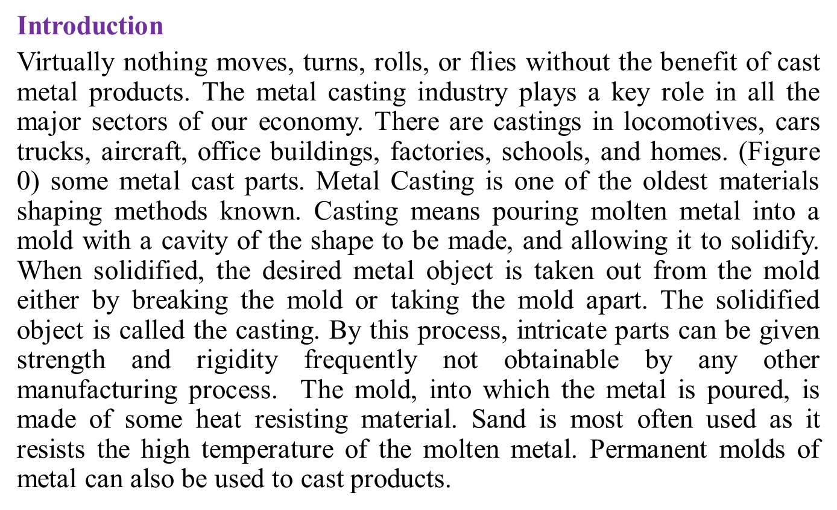
Lecture one
FUNDAMENTALS OF METAL CASTING

Slide 2
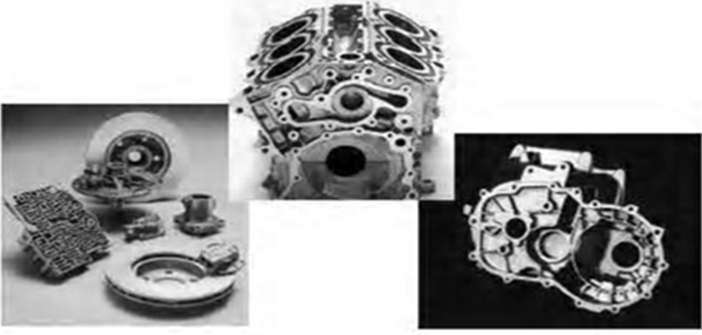
Figure 0: Metal Cast parts

Slide 3


FUNDAMENTALS OF METAL CASTING
Overview of Casting Technology
Heating and Pouring
Solidification and Cooling

Slide 4
Solidification Processes
Starting work material is either a liquid or is in a highly plastic condition, and a part is created through solidification of the material
Solidification processes can be classified according to engineering material processed:
  Metals
  Ceramics, specifically glasses
  Polymers and polymer matrix composites (PMCs)

Slide 5
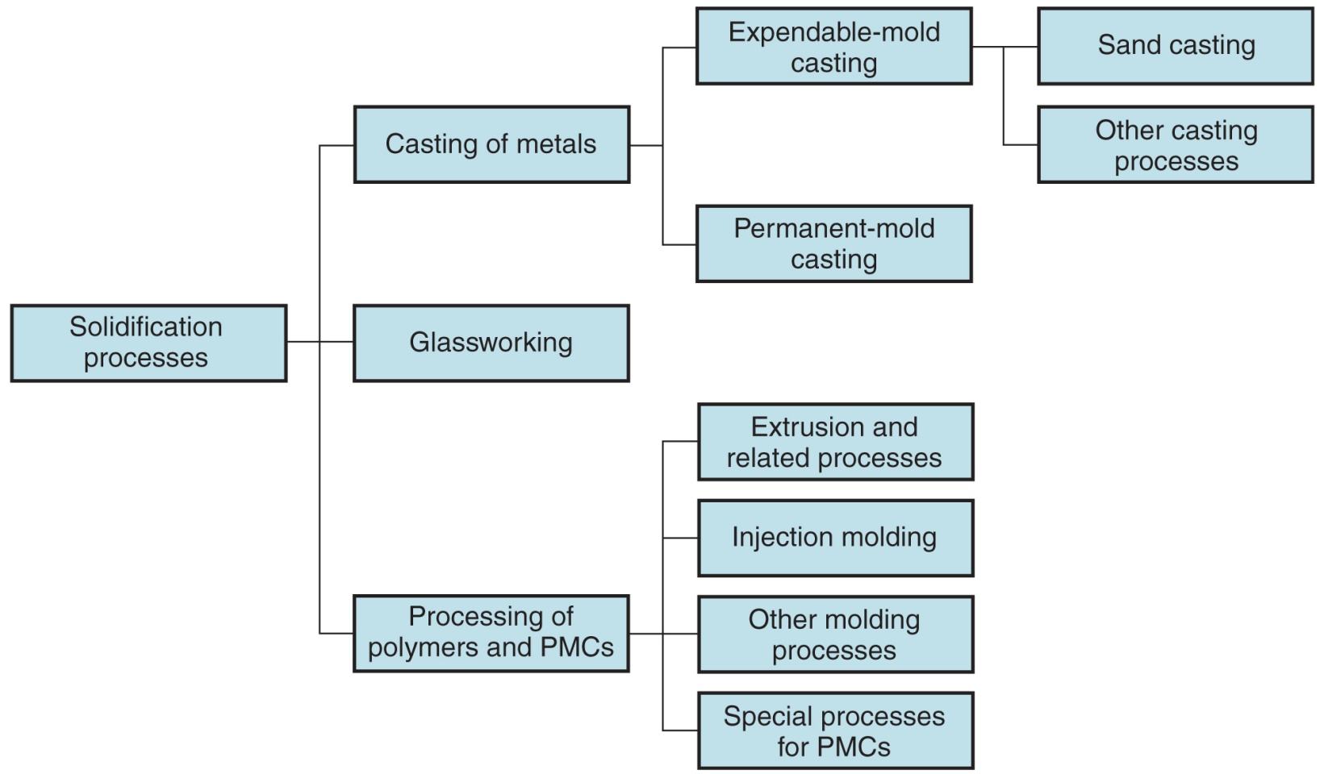
Classification of solidification processes

Slide 6
Casting of Metals
Process in which molten metal flows by gravity or other force into a mold where it solidifies in the shape of the mold cavity
The term casting also applies to the part made in the process
Steps in casting seem simple:
  Melt the metal.
  Pour it into a mold.
  Let it freeze.

Slide 7

Capabilities and Advantages of Casting
Can create complex part geometries.
Can create both external and internal shapes.
Some casting processes are net shape; others are near net shape.
Can produce very large parts.
Some casting methods are suited to mass production.

Slide 8
Disadvantages of Casting
Different disadvantages for different casting processes:
  Limitations on mechanical properties.
  Poor dimensional accuracy and surface finish for some processes; e.g., sand casting.
  Safety hazards to workers due to hot molten metals.
  Environmental problems.

Slide 9
Directional Solidification
To minimize effects of shrinkage, it is desirable for regions of the casting most distant from the liquid metal supply to freeze first and for solidification to progress from these regions toward the riser(s)
  Thus, molten metal is continually available from risers to prevent shrinkage voids.
  The term directional solidification describes this aspect of freezing and methods by which it is controlled.

Slide 10
Achieving Directional Solidification
Directional solidification is achieved using Chvorinov's Rule to design the casting, its orientation in the mold, and the riser system that feeds it
  Locate sections of the casting with lower V/A ratios away from riser, so freezing occurs first in these regions, and the liquid metal supply for the rest of the casting remains open
  Chills ‑ internal or external heat sinks that cause rapid freezing in certain regions of the casting

Slide 11
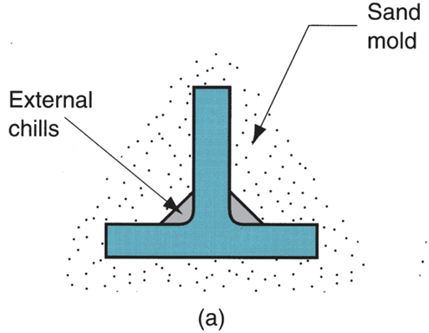
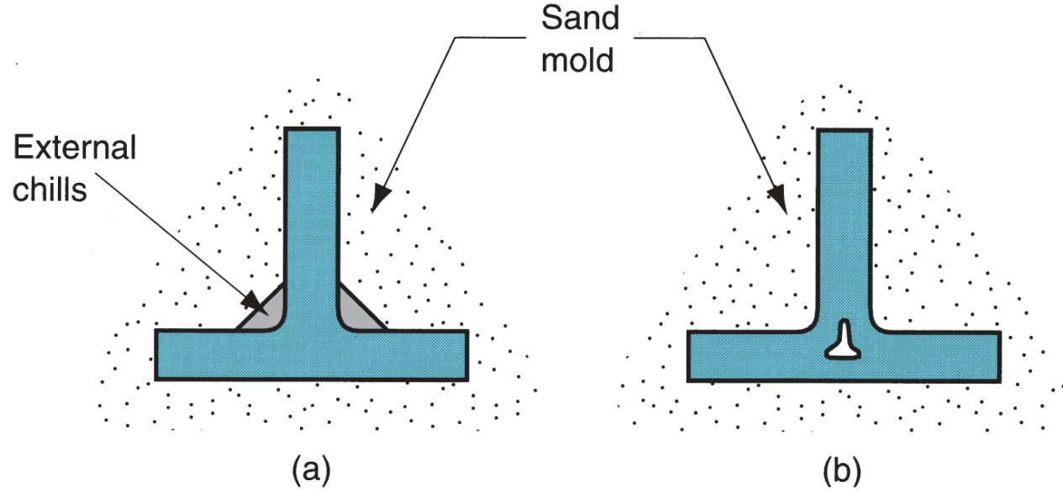
External Chills
(a) External chill to encourage rapid freezing of the molten metal in a thin section of the casting; and
(b) the likely result if the external chill were not used

Slide 12
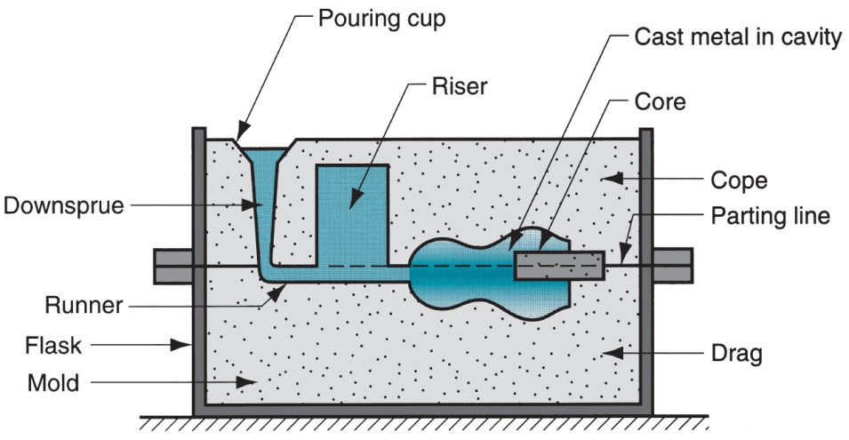

Riser Design
Riser is waste metal that is separated from the casting and re-melted to make more castings
To minimize waste in the unit operation, it is desirable for the volume of metal in the riser to be a minimum
Since the shape of the riser is normally designed to maximize the V/A ratio, this allows riser volume to be reduced to the minimum possible value

Slide 13

Example 1
(SI units) The length of the downsprue leading into the runner of a mold = 200 mm. The cross‑sectional area at its base = 400 mm². Volume of the mold cavity = 0.0012 m³. Determine (a) velocity of the molten metal flowing through the base of the downsprue, (b) volume rate of flow, and (c) time required to fill the mold cavity.
Solution
(a) Velocity v = (2gh)^{0.5} = (2 x 9810 x 200)^{0.5} = (3,924,000)^{0.5} = =1981 mm/s
(b) Volume flow rate Q = vA = 1981 x 400 =792,400 mm³/s
(c) Time to fill cavity T_{MF} = V/Q = 1,200,000/792,400 = 1.515 s

Slide 14
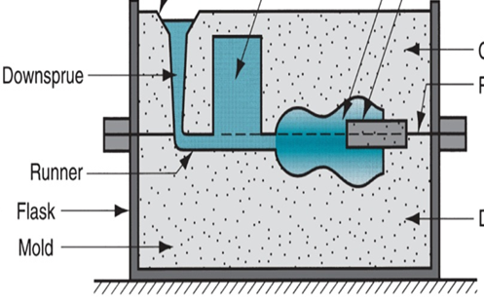
Example 2
(USCS units) The volume flow rate of molten metal into the downsprue from the pouring cup is 45 in³/sec. At the top where the pouring cup leads into the downsprue, the cross‑sectional area = 1.0 in². Determine what the area should be at the bottom of the sprue if its length = 8.0 in. It is desired to maintain a constant flow rate, top and bottom, in order to avoid aspiration of the liquid metal.
Solution:
Velocity at base v = (2gh)^{0.5} = (2 x 32.2 x 12 x 8)^{0.5} = 78.6 in/sec
Assuming volumetric continuity, area at base Q = vA
A = (45 in³/sec)/(78.6 in/sec) = 0.573 in²

Slide 15
Example 3
(SI units) Determine the shrink rule to be used by mold makers for die casting of zinc. Using the shrinkage value in Table 10.1, express your answer in terms of decimal mm of elongation per 300 mm of length compared to a standard 300-mm scale.
Solution: For zinc, shrinkage 2.6% from Table 10.1.
Thus, linear contraction = 1.0 – 0.026 = 0.974.
Shrink rule elongation = (0.974)⁻¹ = 1.0267
For a 300-mm rule, L = 1.0267(300) = 308.008 mm
Elongation per 300 mm of length = 8.008 mm

Slide 16
Example 4
(SI units) In casting experiments performed using a certain alloy and type of sand mold, it took 170 sec for a cube‑shaped casting to solidify. The cube was 50 mm on a side. (a) Determine the value of the mold constant in Chvorinov's rule. (b) If the same alloy and mold type were used, find the total solidification time for a cylindrical casting in which the diameter = 50 mm and length = 50 mm.use mold constant in Chvorinov's rule = 2.232s/mm²
Solution: (a) Volume V = (50)³ = 125,000 mm³
Area A = 6 x (50)² = 15,000 mm²
(V/A) = 125,000/15,000 = 8.333 mm
C_{m} = T_{TS} /(V/A)² = 170/(8.333)² = 2.448 s/mm²
(b) Cylindrical casting with D = 50 mm and L = 50 mm.
Volume V = πD²L/4 = π(50)²(50)/4 = 98,175 mm³
Area A = 2πD²/4 + πDL = π(50)²/2 + π(50)(50) = 11,781 mm²
V/A = 98,175 /11,781 = 8.333
C_{m} = T_{TS} /(V/A)² T_{TS} = 2.232 (8.333)² = 154.87s = 2.581 min

